Slide 1
This PowerPoint
Is created as a companion to Child Growth and Development by College of the Canyons, Jennifer Paris, Antoinette Ricardo, and Dawn Rymond and is used under a CC BY 4.0 international license
The text comes from content in the book which has varied licensing
The images all include licensing information

Slide 2
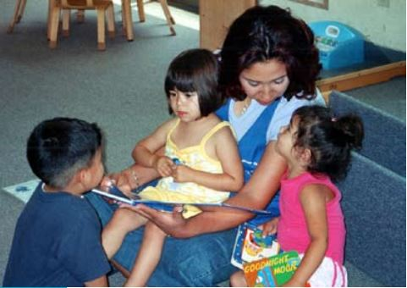
Language Development In Early Childhood
Image is used with permission from the California Department of Education

Slide 3
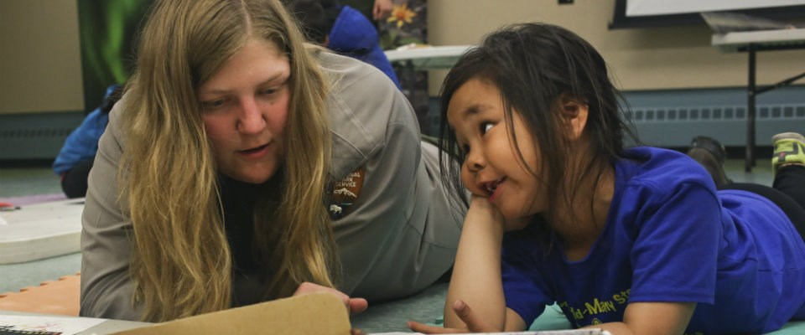
Vocabulary Growth
Between 2 and 6 a child’s vocabulary goes from about 200 to over 10,000 words!
This is largely due to fast-mapping
Impacted by language and emphasis
Image by the U.S. Department of the Interior is in the public domain

Slide 4
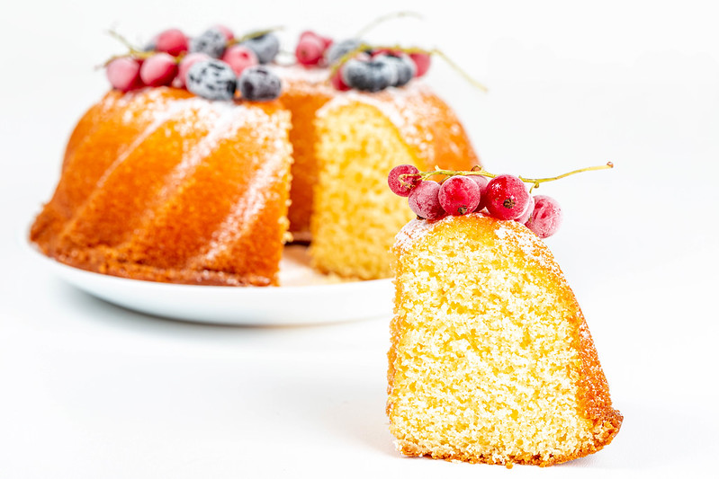
Literal Meanings and Overregularization
May use before they understand the true meaning of phrases
Piece of cake
As they learn the rules of grammar, they apply those rules uniformly
“I eated that cake” → “I ate that cake”
Image by Marco Verch Professional Photographzer is licensed under CC BY 2.0

Slide 5
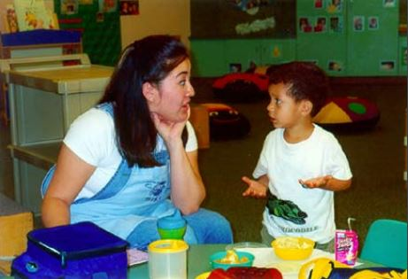
The Impact of Training
Children can be assisted in learning language by others that
Listen attentively
Model accurate pronunciations
Encourage elaboration
Image is used with permission from the California Department of Education

Slide 6
Language Milestones
Typical Age | What Most Children Do by This Age
3 years | Follows instructions with 2 or 3 steps Can name most familiar things Understands words like “in,” “on,” and “under” Says first name, age, and sex Names a friend Says words like “I,” “me,” “we,” and “you” and some plurals (cars, dogs, cats) Talks well enough for strangers to understand most of the time Carries on a conversation using 2 to 3 sentences

Slide 7
Language Milestones cont.
Typical Age | What Most Children Do by This Age
4 years | Knows some basic rules of grammar, such as correctly using “he” and “she” Sings a song or says a poem from memory such as the “Itsy Bitsy Spider” or the “Wheels on the Bus” Tells stories Can say first and last name
5 years | Speaks very clearly Tells a simple story using full sentences Uses future tense; for example, “Grandma will be here.” Says name and address

Slide 8
This PowerPoint was created by Jennifer Paris. Except where otherwise noted, it is licensed under a Creative Commons Attribution 4.0 International License.

