Slide 1
This PowerPoint
Is created as a companion to Child Growth and Development by College of the Canyons, Jennifer Paris, Antoinette Ricardo, and Dawn Rymond and is used under a CC BY 4.0 international license
The text comes from content in the book which has varied licensing
The images all include licensing information

Slide 2
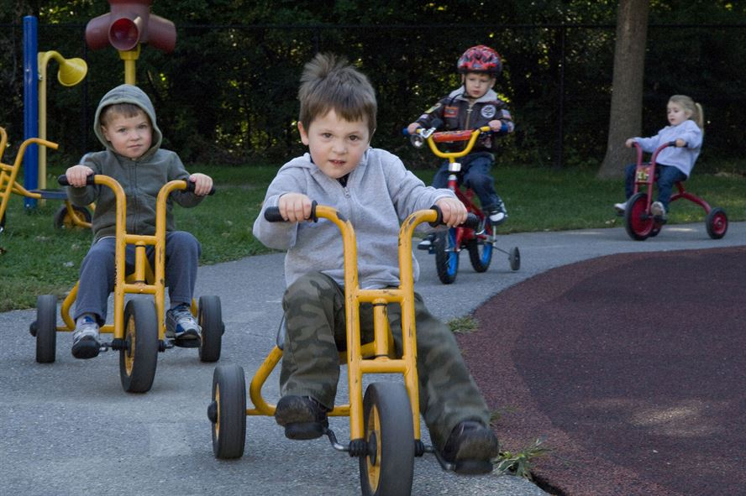
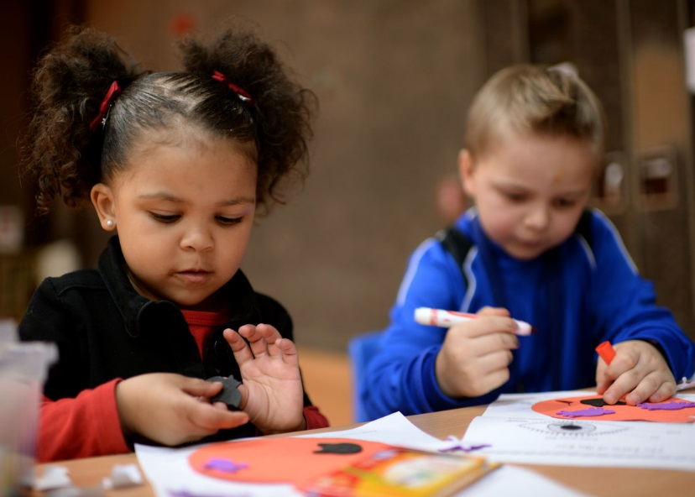
Physical Development In Early Childhood
Image by Hanscom Air Force Base is in the public domain
Image by Spangdahlem Air Base is in the public domain

Slide 3
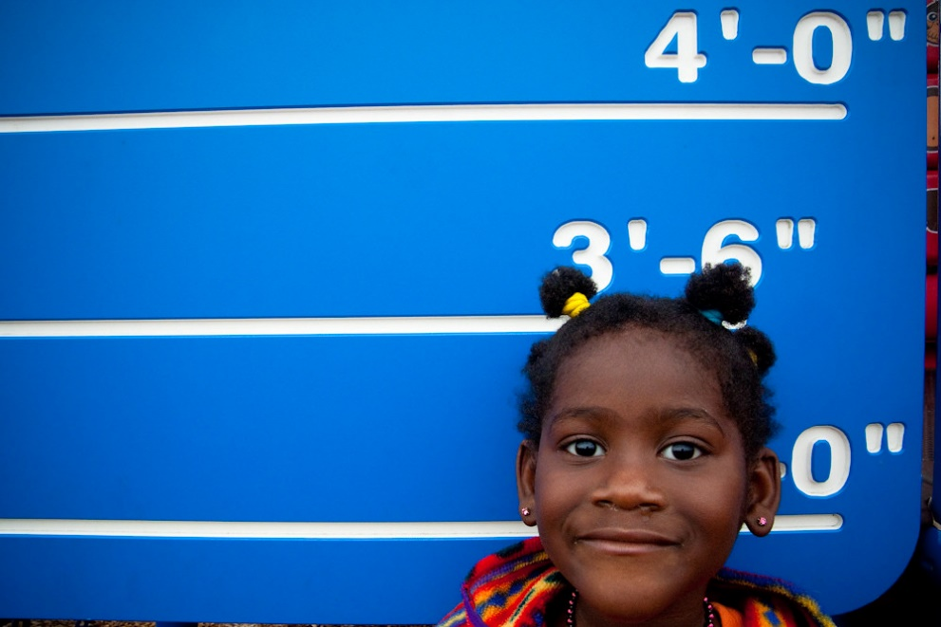
Growth in Early Childhood
Between 2 and 6 years of, children gain about 3 inches in height and 4 to 5 pound in weight each year
Little Black Girl Measure Height 3' 6" Ruler Manhattan Park Playground October 23, 20106 by Stephen Depolo is licensed under CC-BY 2.0

Slide 4
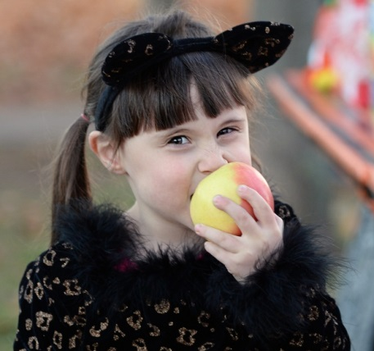
Nutrition
Slower growth = reduced appetite
2- to 3-year olds need 1,000-1,400 calories per day
4- to 8-year olds need 1,200-2,000 calories daily
Important to provide adequate and well-balanced nutrition
Modified from U.S. Air Force photo by Senior Airman Jimmie D. Pike in public domain

Slide 5
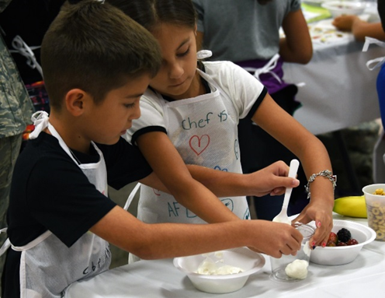
Nutrition cont.
Children are developing their taste preferences at this age
7 Tips for Establishing Health Eating Habits
Don’t force a child to eat or fight over food
Recognize that appetite varies
Keep it pleasant
No short order chefs
Limit choice
Serve balanced meals
Don’t bribe
Image by the Air Force Medical Service is in the public domain

Slide 6
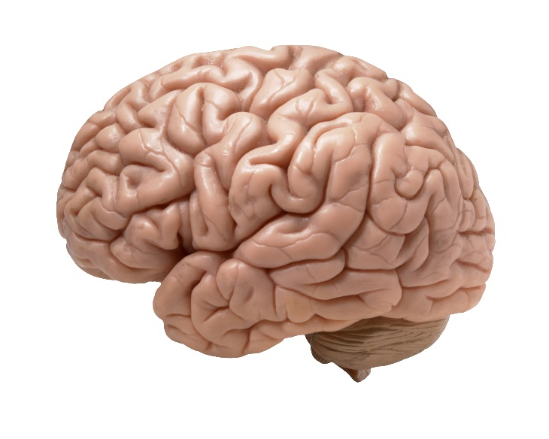
Brain
75% of adult weight at age 2 → 95% at age 6
Significant gains in prefrontal cortex → better self-regulation
Drawings are representative of visual pathways in brain
Dramatic growth of left hemisphere of brain (language)
Corpus callosum growth spurt between 3 and 6
Image by _DJ_ is licensed under CC BY-SA 2.0

Slide 7
Gross Motor Skills
Being active is the business of early childhood
Typical Age | What Most Children Do by This Age
3 years | Climbs well Runs easily Pedals a tricycle (3-wheel bike) Walks up and down stairs, one foot on each step
4 years | Hops and stands on one foot up to 2 seconds Catches a bounced ball most of the time
5 years | Stands on one foot for 10 seconds or longer Hops; may be able to skip Can do a somersault Can use the toilet on own Swings and climbs

Slide 8
Fine Motor Skills
Being refined as dexterity, strength, and endurance increase
Typical Age | What Most Children Do by This Age
3 years | Copies a circle with pencil or crayon Turns book pages one at a time Builds towers of more than 6 blocks Screws and unscrews jar lids or turns door handle
4 years | Pours, cuts with supervision, and mashes own food Draws a person with 2 to 4 body parts Uses scissors Starts to copy some capital letters
5 years | Can draw a person with at least 6 body parts Can print some letters or numbers Copies a triangle and other geometric shapes Uses a fork and spoon and sometimes a table knife

Slide 9
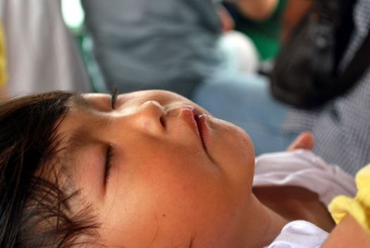
Sleep
Important physiological need
Young children need about 10 to 11 hours of sleep
Child may experience
Sleepwalking
Sleep terrors
Nightmares
Image by Peter Griffin is in the public domain

Slide 10
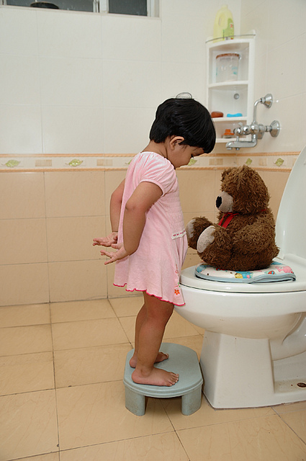
Toilet Training
Typically occurs after 2nd birthday
98% are toilet trained by 36 months
But readiness is more important than age
Daytime bladder control is typically accomplished first
Elimination disorders
Enuresis
Encopresis
Image by Manish Bansal is licensed under CC-BY-2.0

Slide 11
This PowerPoint was created by Jennifer Paris. Except where otherwise noted, it is licensed under a Creative Commons Attribution 4.0 International License.

