Slide 1
This PowerPoint
Is created as a companion to Child Growth and Development by College of the Canyons, Jennifer Paris, Antoinette Ricardo, and Dawn Rymond and is used under a CC BY 4.0 international license
The text comes from content in the book which has varied licensing
All images include licensing information

Slide 2
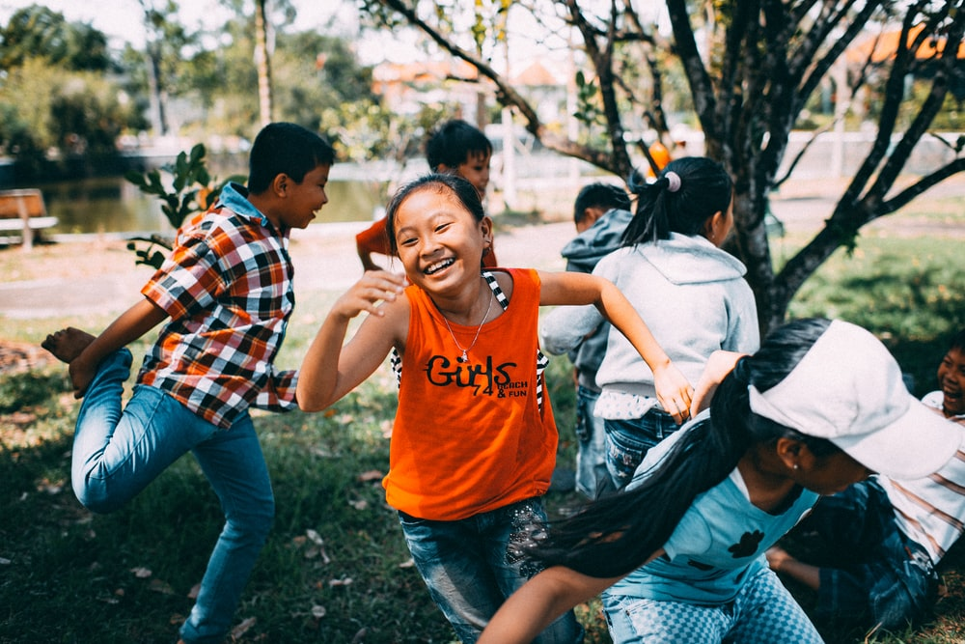
Physical Development In Middle Childhood
Image by MI PHAM is freely available on Unsplash

Slide 3
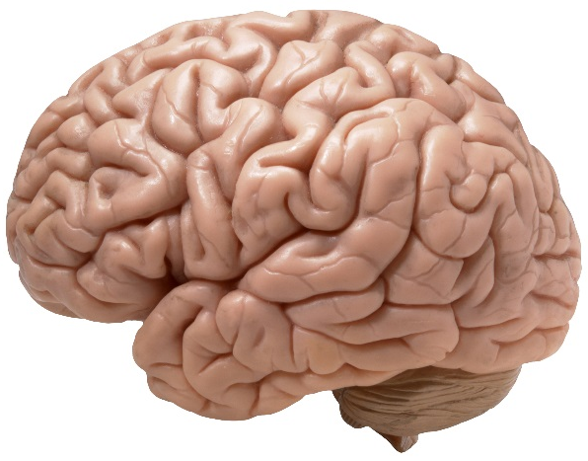
Brain Development
Brain reaches adult size about age 7
During middle childhood improvements in
Logic, planning, and memory
Hemisphere coordination
Attention span
Reaction time and information processing speed
Image by _DJ_ is licensed under CC BY-SA 2.0

Slide 4
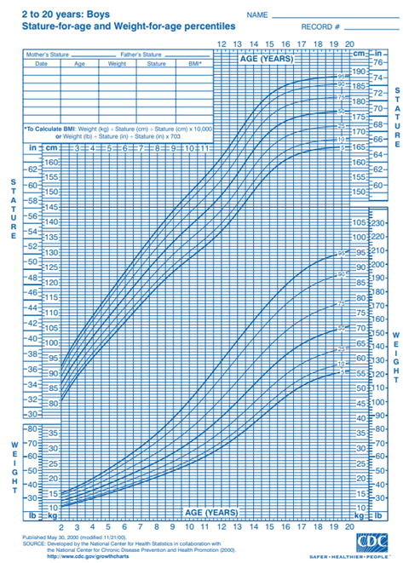
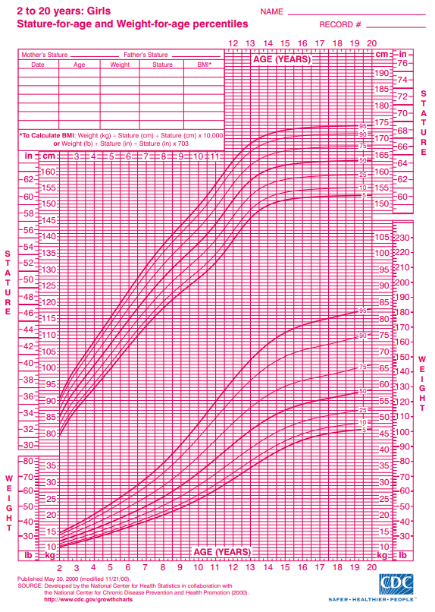
Physical Growth
Growth rates are slow and steady
5-7 pounds per year
About 2 inches per year
Slimming down and gaining muscle strength
Bones lengthen and muscles strengthen
Faster growth in extremities → adult-like proportions
Images by the CDC are in the public domain

Slide 5
Motor Skill Improvement
Significant improvement in motor skills from 6 to 9 years
Eye-hand coordination and fine motor skills → better writing and cutting
Sports and extracurricular activities
Image by Greg Rosenke is freely available on Unsplash

Slide 6
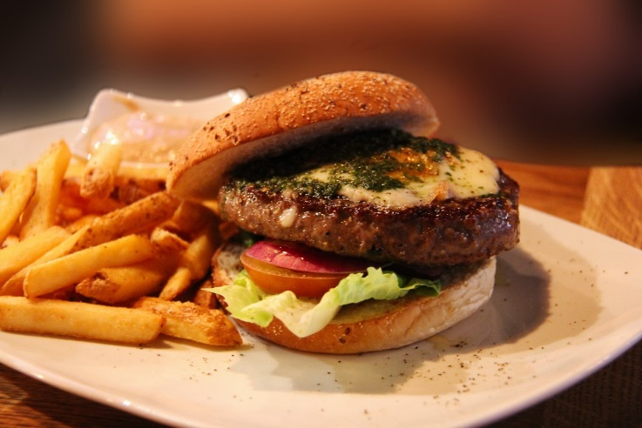
Nutrition
Habits and attitudes toward food influenced by many things
Need to be directed towards healthy choices and given nutrient dense foods
Importance of parents and caregivers
Reinforcing good habits and introducing new foods into diet
Being good role models
Diet today shows increase in fat, processed foods, portion size
Image is licensed under CC0

Slide 7
Energy Needs
These vary based on growth, level of physical activity, and gender
Girls
4-8 years: 1,200-1,800 calories
9-13 years: 1,400-2,200 calories
Boys
4-8 years: 1,200-2,000 calories
9-13 years: 1,600-2,600 calories
Image from the NIH is in the public domain

Slide 8
Vegetarianism
Families or children may choose to pursue a vegetarian diet
Ovo-vegetarians
Lacto-ovo-vegetarians
Lacto-vegetarians
Vegans
Strict vegan diets require careful planning
Image by Sunnya343 is licensed under CC BY-SA 4.0

Slide 9
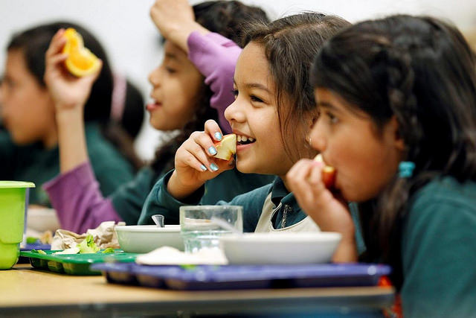
Malnutrition
Millions of children grow up in food insecure households
This can lead to numerous problems
Deficiencies → stunted growth, illness, and developmental delays
Programs such as the National School Lunch Program and School Breakfast program work to provide access to nutritious foods
Image by the USDA is in the public domain

Slide 10
Food Allergies and Intolerances
3 million children under age 18 are allergic to at least one food
Allergy = immune response
Includes anaphylaxis
Intolerance = unpleasant reactions that are not an immune response
Image by Sean William is licensed under CC BY-SA 3.0

Slide 11
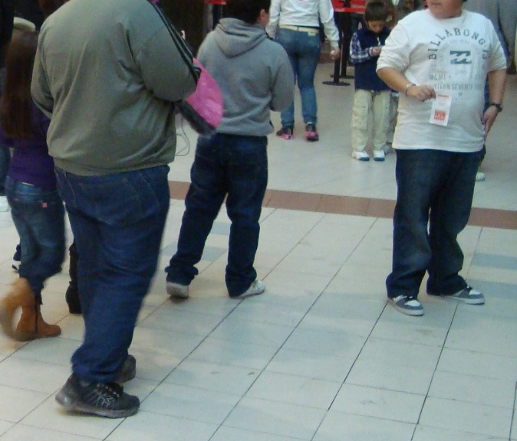
Overweight and Obesity in Childhood
Excess weight is associated with
Health problems
Impaired brain functioning
Damage to social and emotional well-being
Current measurement is Body Mass Index (BMI)
Overweight: BMI is over 85th percentile
Obese: BMI is over 95th percentile
Can be lifelong problem
Should be handled with behavioral interventions, not dieting
Image by Gaulsstin is licensed under CC BY 2.0

Slide 12
This PowerPoint was created by Jennifer Paris. Except where otherwise noted, it is licensed under a Creative Commons Attribution 4.0 International License.

