Slide 1
This PowerPoint
Is created as a companion to Child Growth and Development by College of the Canyons, Jennifer Paris, Antoinette Ricardo, and Dawn Rymond and is used under a CC BY 4.0 international license
The text comes from content in the book which has varied licensing
The images all include licensing information

Slide 2
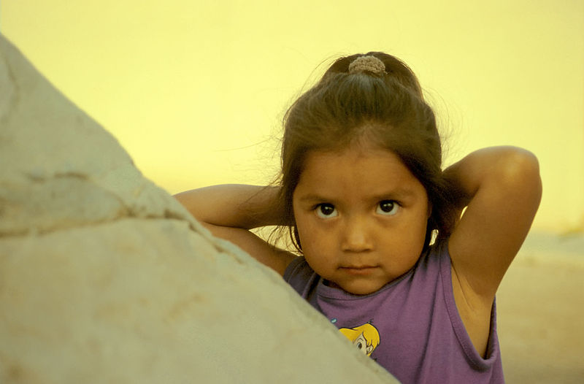
Personality
Girl in the Hopi Reservation by Michael Gabler is licensed under CC-BY 3.0

Slide 3
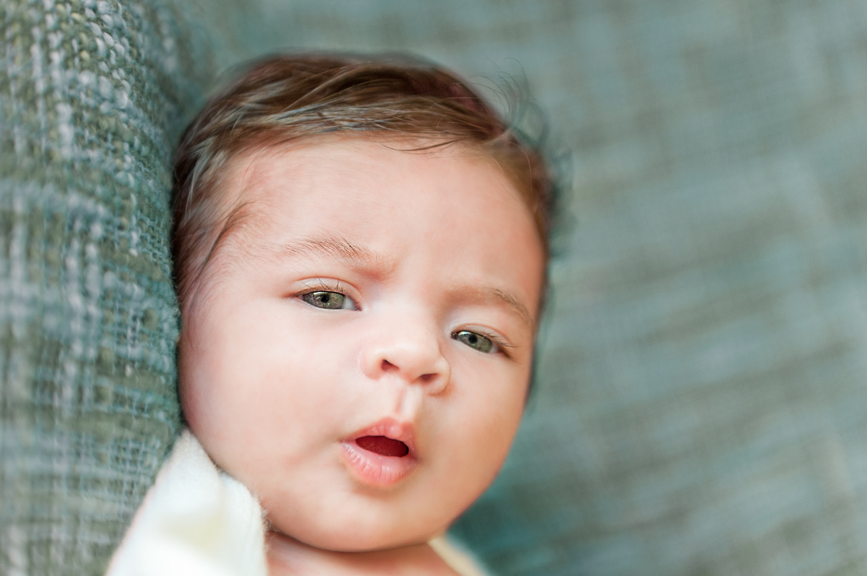
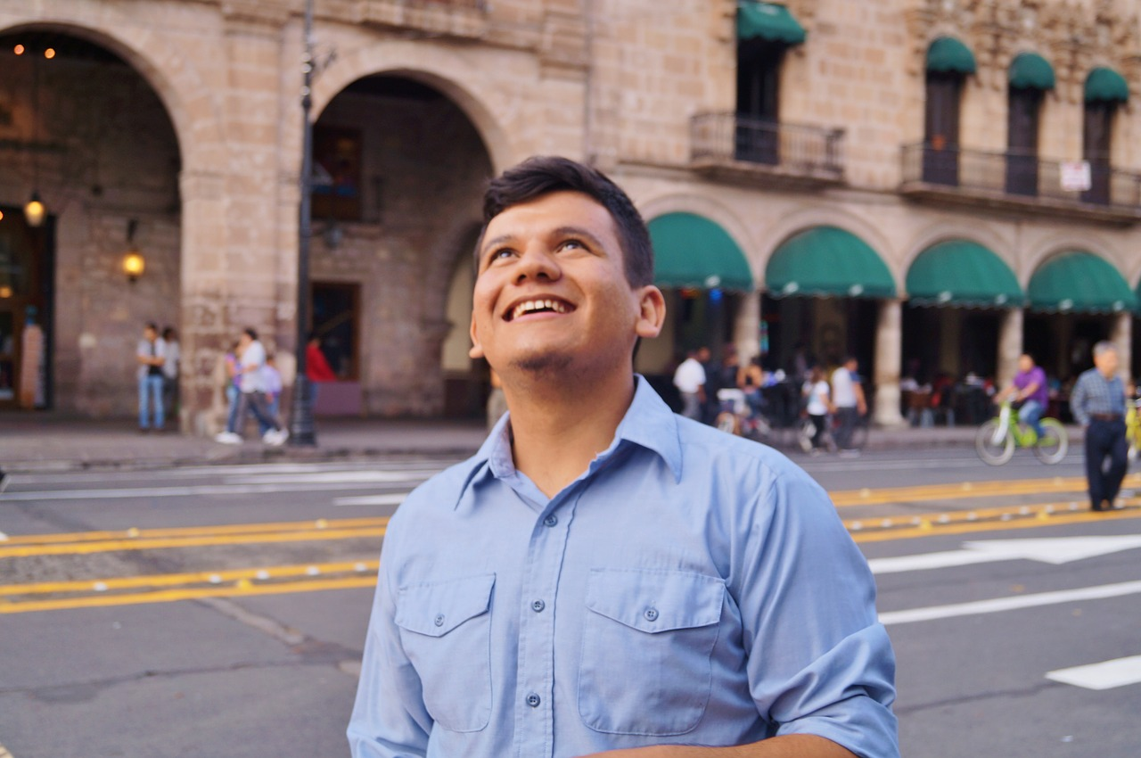
Definition
An individual’s consistent pattern of feeling, thinking, and behaving
Result of a continuous interplay between biological disposition and experience
Begins with temperament but becomes increasingly more elaborated, extended, and refined with time
Baby by Gabriel Pinto is licensed under CC-BY 2.0
Image by yeu_rodvall is licensed under CC0

Slide 4
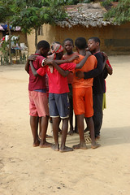
Culture and Personality
With culture, comes norms and expectations
Those influence the traits that are recognized and valued
Which affects how personality is expressed across cultures
Image from Air Force is in the public domain
Image by Julien Harneis is CC-BY-SA 2.0

Slide 5
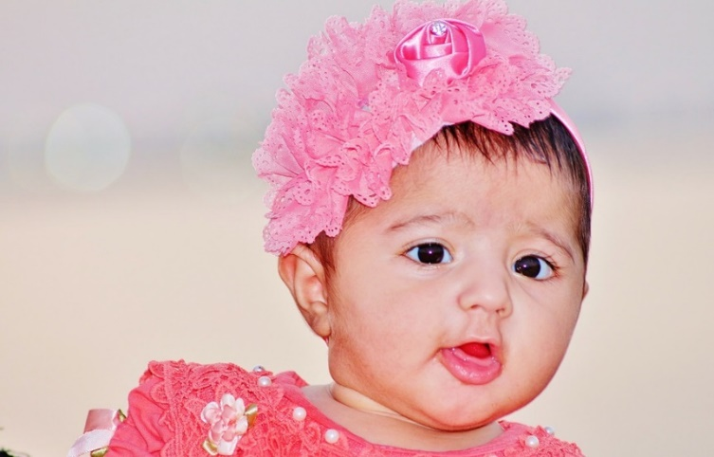
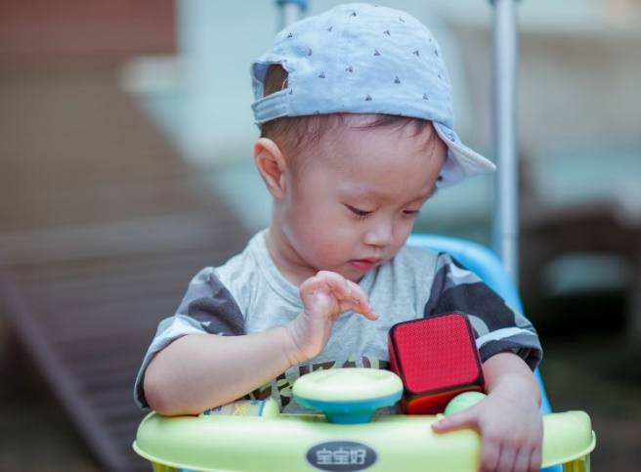
Gender and Personality
Gender norms can also influence personality
Image by Abdullah Shakoor on Pixabay
Image by An Min is licensed under CC0 1.0

Slide 6
This PowerPoint was created by Jennifer Paris. Except where otherwise noted, it is licensed under a Creative Commons Attribution 4.0 International License.

