Slide 1
This PowerPoint
Is created as a companion to Child Growth and Development by College of the Canyons, Jennifer Paris, Antoinette Ricardo, and Dawn Rymond and is used under a CC BY 4.0 international license
The text comes from content in the book which has varied licensing
All images include licensing information

Slide 2
Concreate Operational Thought
Image by Joseph Gonzalez is freely available on Unsplash

Slide 3
Introduction
Thought process become more logical and organized with concrete information
Begin to understand past, present, and future → ability to plan and work towards goals
Processing complex ideas
Image by Annie Spratt is freely available on Unsplash

Slide 4
Piaget’s Concrete Operational Thought
Around 7 to 11 years of age
Able to represent ideas and events more flexibly and logically
Basic rules of thinking allow for systematic problem solving
Logic can only be applied to physical objects
Image by SchoolPRPro is freely available on Pixabay

Slide 5
Skills Children Master During Concrete Operational Stage
Seriation: arranging items by qualitative dimension
Classification: organizing objects into classes and subclasses
Image by MehreenH is licensed CC BY-SA 4.0
Image by Soraya Irving is freely available on Unsplash

Slide 6
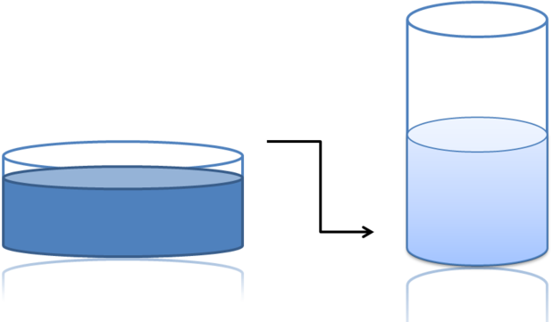
Skills Children Master During Concrete Operational Stage cont.
Reversibility: some things that are changed can be returned to their original state
Conservation: changing on quality can be compensated for children in another quality
Image by Ydolem2689 is licensed under CC BY-SA 3.0
Image by John Voo is licensed under CC BY 2.0

Slide 7
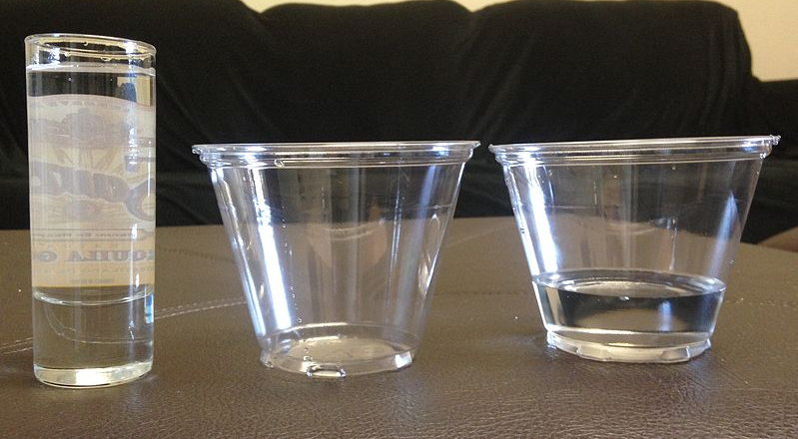
Skills Children Master During Concrete Operational Stage cont.
Decentration: focusing on more than one dimension of an object
Identity: objects have qualities that do not changed even when the object is altered
Image by Waterlily16 is licensed under CC BY-SA 3.0
Image is freely available from Pexels

Slide 8
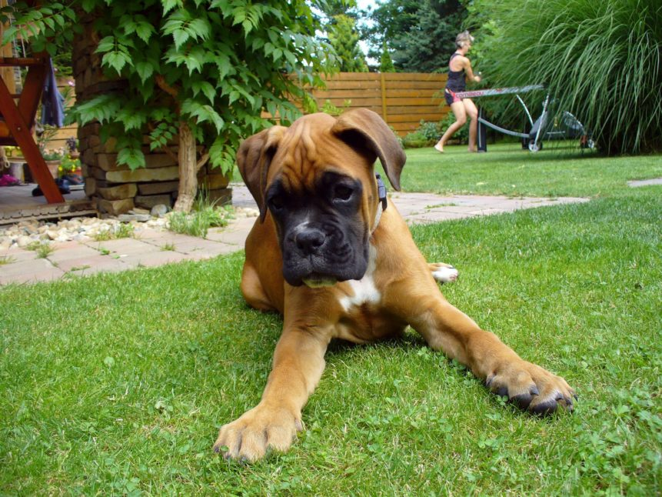
Skills Children Master During Concrete Operational Stage cont.
Transitivity: an ability to see how objects are related
Image by Martin Vorel is in the public domain

Slide 9
This PowerPoint was created by Jennifer Paris. Except where otherwise noted, it is licensed under a Creative Commons Attribution 4.0 International License.

