Slide 1
This PowerPoint
Is created as a companion to Child Growth and Development by College of the Canyons, Jennifer Paris, Antoinette Ricardo, and Dawn Rymond and is used under a CC BY 4.0 international license
The text comes from content in the book which has varied licensing
The images all include licensing information

Slide 2
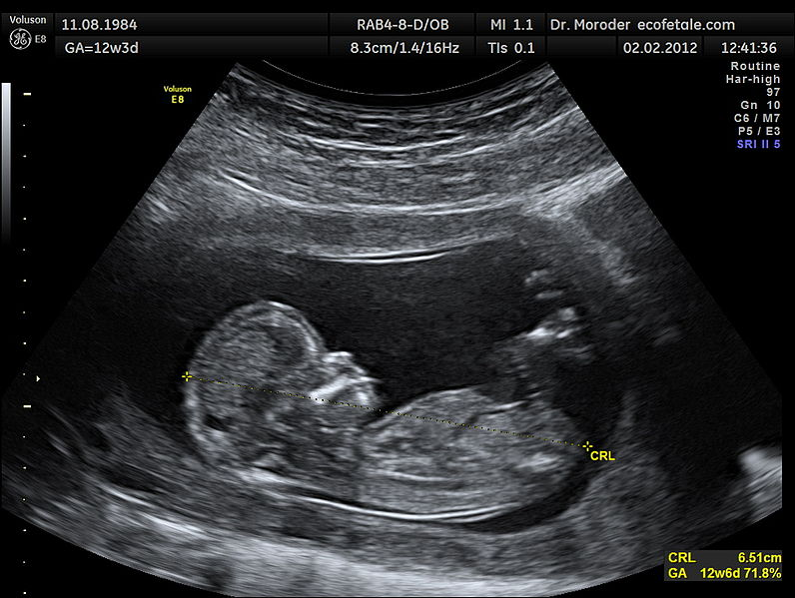
Prenatal Development
Image by Wolfgang Moroder is licensed under CC BY-SA 3.0

Slide 3
The Germinal Period
Begins at conception
Continues through implantation
About 14 days
Less than half zygotes survive
Image by Ttrue12 is licensed under CC BY-SA 3.0

Slide 4
The Embryonic Period
Weeks 3-8
Placenta forms
Cells continue differentiation
Growth
Cephalocaudal development
Proximodistal development
20% rate of spontaneous abortion
Image by Anatomist90 is licensed under CC BY-SA 3.0

Slide 5
The Fetal Period
Image by CNX Psychology is licensed under CC BY 4.0

Slide 6
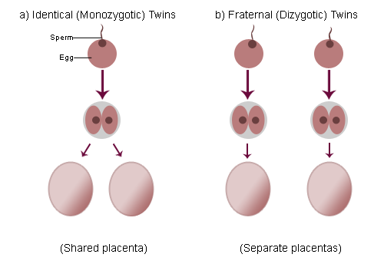
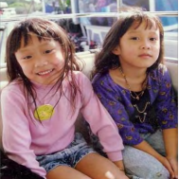
Twins
Monozygotic Dizygotic
Image is in the public domain
Image by Jennifer Paris used with permission
Image by Trlkly is licensed under CC BY-SA 3.0
Image by Trlkly is licensed under CC BY-SA 3.0

Slide 7
Teratogens
Factors
Timing
Amount
Number of teratogens
Genetics
Male or female
Categories
Physical teratogens
Metabolic conditions
Infections
Drugs and chemicals
Image by Laura Overstreet is licensed under CC BY-NC-SA 3.0

Slide 8
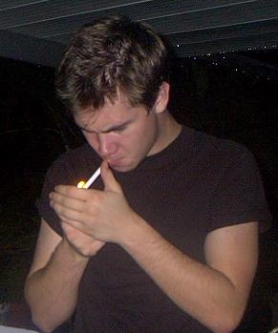
Parental Factors
Paternal
Maternal
Advanced age
Teratogens
Advanced age
Teenage pregnancy
Gestational diabetes
High blood pressure
Rh disease
Weight gain
Stress
Depression
Image is licensed under CC BY-SA 3.0

Slide 9
Prenatal Assessment
Ultrasound
Amniocentesis
Chorionic villus sampling
Image by MedicalPrudens is licensed under CC0 1.0
Image by BruceBlaus is licensed under CC BY-SA 4.0

Slide 10
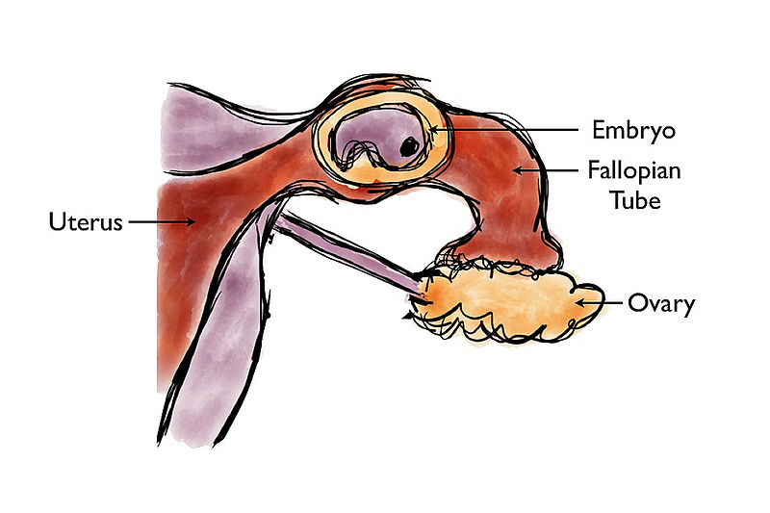
Complications of Pregnancy
Hyperemesis gravidarum
Ectopic pregnancy
Spontaneous abortion (miscarriage)
Preeclampsia
Maternal mortality
Image by Takatakatakumi is licensed under CC BY-SA 3.0

Slide 11
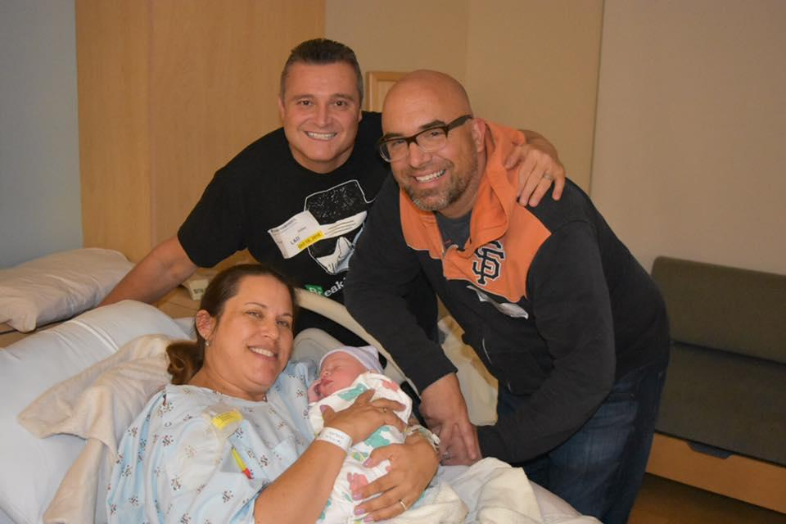
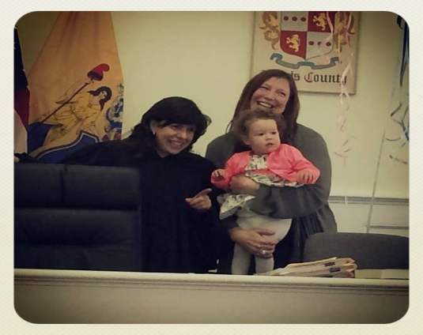
Infertility and Building Families
10-15% of U.S. couples
Male factor, female factor, both
Options for building families
Assistive Reproductive Technology (ART)
Intrauterine insemination (IUI)
In vitro fertilization (IVF)
Donor gametes and embryos
Surrogacy
Adoption
Photo by Daryn Crawford used with permission
Photo by Michaela Szidloski used with permission

Slide 12
This PowerPoint was created by Jennifer Paris. Except where otherwise noted, it is licensed under a Creative Commons Attribution 4.0 International License.

