Slide 1
This PowerPoint
Is created as a companion to Child Growth and Development by College of the Canyons, Jennifer Paris, Antoinette Ricardo, and Dawn Rymond and is used under a CC BY 4.0 international license
The text comes from content in the book which has varied licensing
The images all include licensing information

Slide 2
Heredity
Image is in public domain

Slide 3
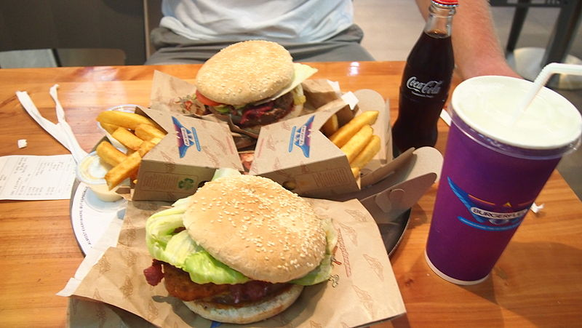
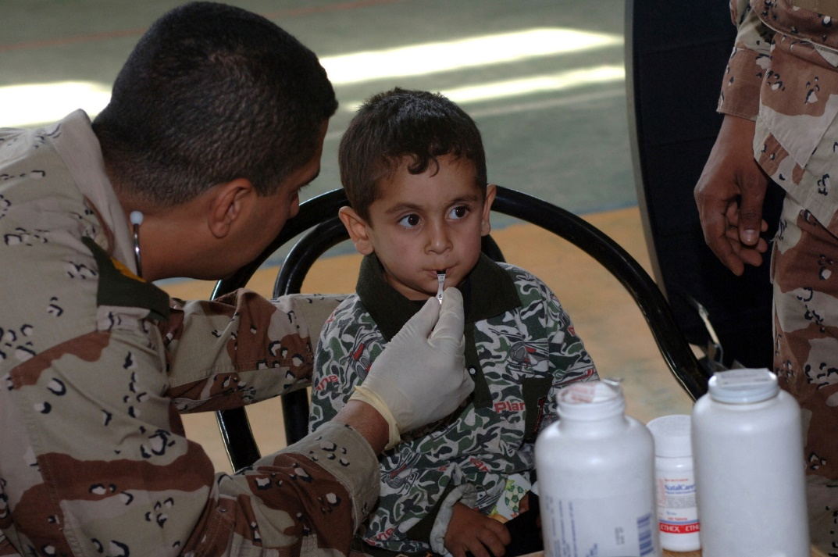
Heredity
Nature and Nurture
Epigenetic framework
Image by Peg93 is licensed under CC BY-SA 3.0
Image is in the public domain

Slide 4
Environment Correlations
Passive-genotype-environment correlation
Evocative-genotype-environment correlation
Image by Alexey Ruban on Unsplash
Image by North Charleston is licensed under CC BY-SA 2.0

Slide 5
Environment Correlations
Active-genotype-environment correlation
Genotype-Environment Interaction
Image is in public domain
Image is public domain

Slide 6
Genes and Chromosomes
Image by Radio89 is licensed under CC BY-SA 3.0 (original image has been modified)

Slide 7
Genes and Chromosomes
Image by Community College Consortium for Bioscience Credentials is licensed under CC BY 3.0

Slide 8
Genes and Chromosomes
Image by Nami-ja is in the public domain

Slide 9
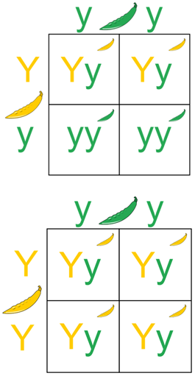
Patterns of Inheritance
Genotype
Phenotype
Homozygous vs. Hetereozygous
Image by KatieAnne127 is licensed under CC BY-SA 4.0

Slide 10
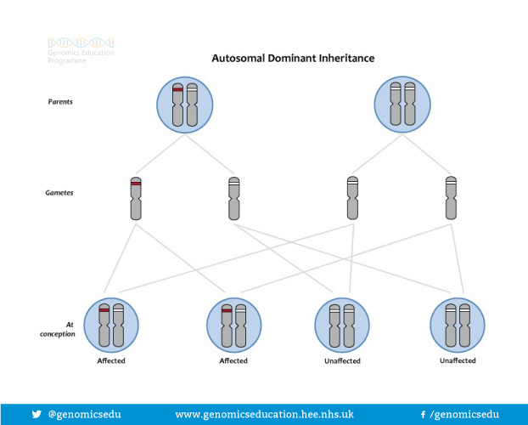
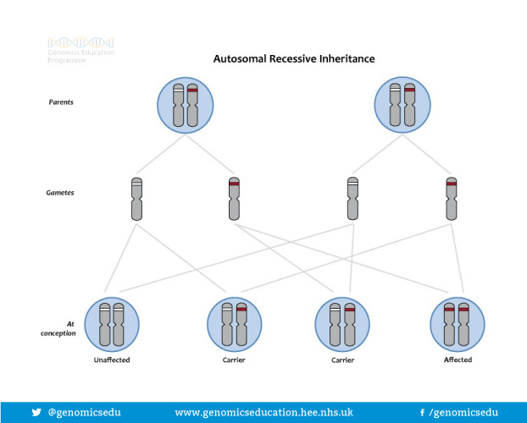
Patterns of Inheritance
Dominant vs. recessive
Polygenic
Image by Genomics Education Programme is licensed under CC BY 2.0
Image by Genomics Education Programme is licensed under CC BY 2.0

Slide 11
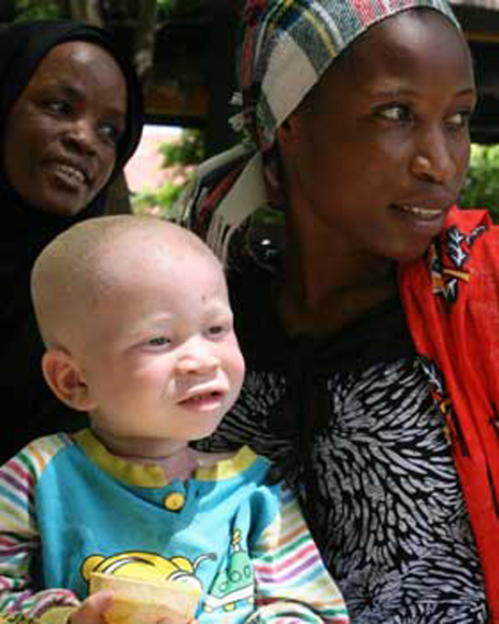
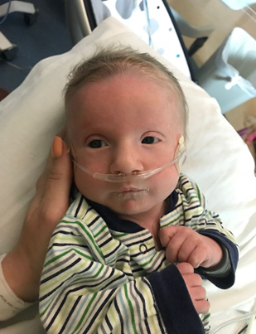
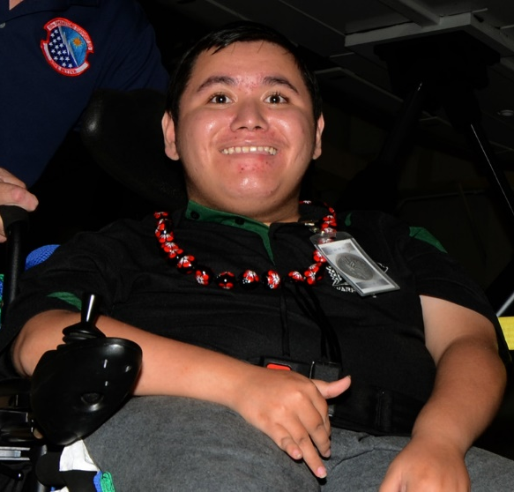
Genetic & Chromosomal Disorders
Sex-linked
Dominant Recessive Sex-linked Chromosomal Chromosomal
Disorders Disorders Disorders Disorders Disorders
Image is in the public domain
Image by Kyle Pacek is licensed under CC BY-SA 3.0
Image by CNX OpenStax is licensed under CC BY 4.0
Image by Ashley Onken used with permission
Image is in the public domain

Slide 12
This PowerPoint was created by Jennifer Paris. Except where otherwise noted, it is licensed under a Creative Commons Attribution 4.0 International License.

