Slide 1
This PowerPoint
Is created as a companion to Child Growth and Development by College of the Canyons, Jennifer Paris, Antoinette Ricardo, and Dawn Rymond and is used under a CC BY 4.0 international license
The text comes from content in the book which has varied licensing
All images include licensing information

Slide 2
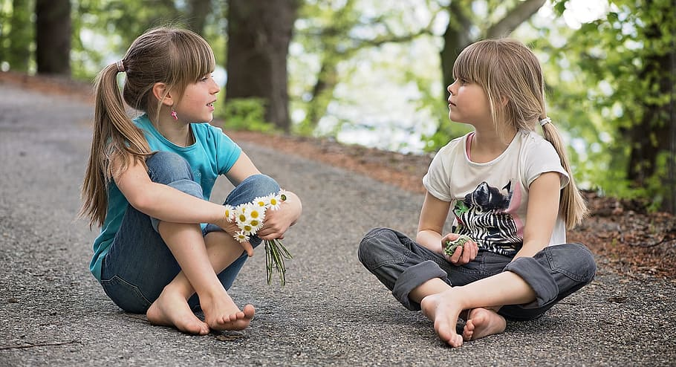
Language Development In Middle Childhood
Image is freely available on pxfuel

Slide 3
Language Development in the School-Aged Child
Human language is most complex behavior
Involves both
Receptive language: ability to understand language
Expressive language: ability to use language to express yourself
Most languages are spoken
Image by Marina del Castell is licensed under CC BY 2.0

Slide 4
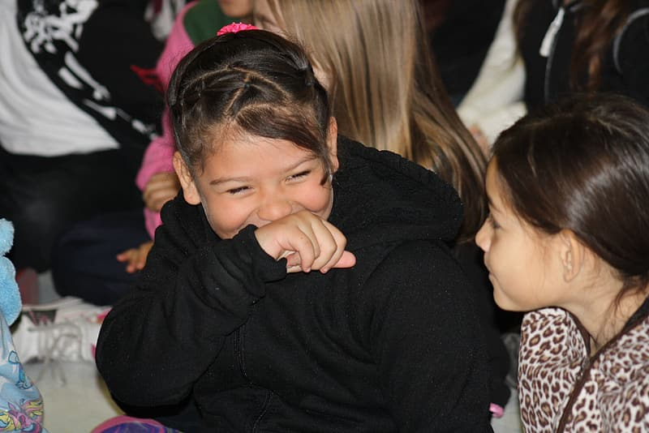
Uses of Language
Transmission of information
Access of existing information
Draw conclusions
Set and accomplish goals
Understand and communicate complex social relationships
Fundamental to our ability to think
Image is freely available on Pikrepo

Slide 5
Linguistics
Image is in the public domain

Slide 6
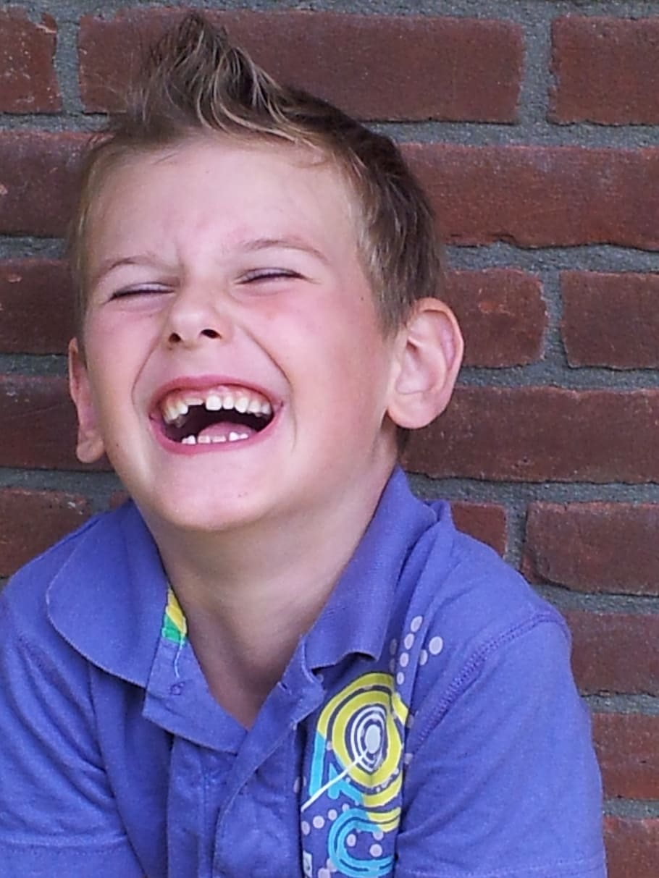
Cognitive Language and Communication
Learning language is complex
Includes comprehension, fluency, and meaning
Lexicon: total of the words in a language
Grammar: the rules (and exceptions) of a language
Vocabulary: the words a person knows
Context: knowing that word meaning changes on situation
At this age language is used less literally
Image is freely available on pxfuel

Slide 7
This PowerPoint was created by Jennifer Paris. Except where otherwise noted, it is licensed under a Creative Commons Attribution 4.0 International License.

