Slide 1
This PowerPoint
Is created as a companion to Child Growth and Development by College of the Canyons, Jennifer Paris, Antoinette Ricardo, and Dawn Rymond and is used under a CC BY 4.0 international license
The text comes from content in the book which has varied licensing
The images all include licensing information

Slide 2
The Newborn
Image by the U.S. Air Force is in the public domain

Slide 3
Assessing Health
Image by Event Medicine Group

Slide 4
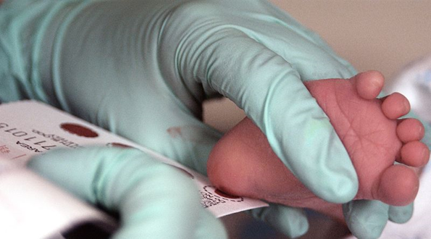
Assessing Health cont.
Neonatal Behavioral Assessment Scale
Heel stick blood testing
Screens for problems with hearing and heart
Image by the U.S. Air Force is in the public domain

Slide 5
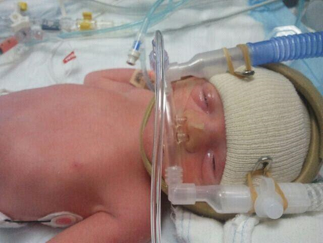
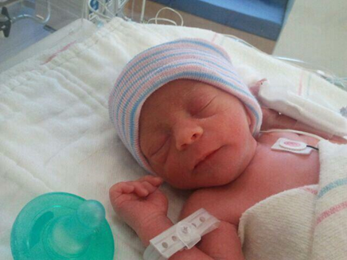
Problems on the Newborn
Anoxia – lack of oxygen to the brain
Low Birth Weight – under 5 pounds 8 oz.
Preterm – born before 37 weeks
Small-for-Date – weight less than 90% of babies at same age
Postmature – born after 42 weeks
Stillborn – death in the womb after 20-24 weeks
Photos by Jennifer Paris used with permission

Slide 6
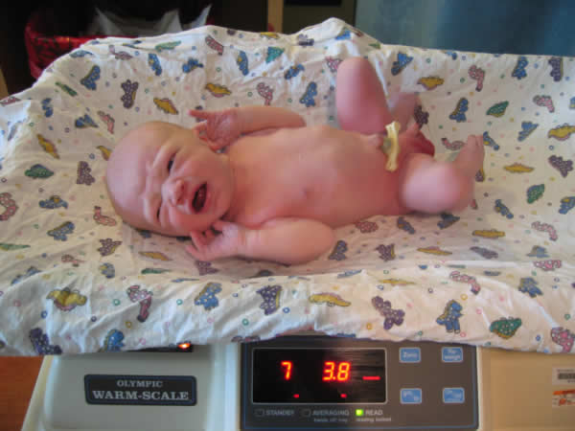
Characteristics of Newborns
Average size – 7.5 pounds and 20 inches long
Head makes about 25% of length
All neurons presents (but not the connections)
Image by Trei Brundrett is licensed under CC BY-SA 2.0

Slide 7
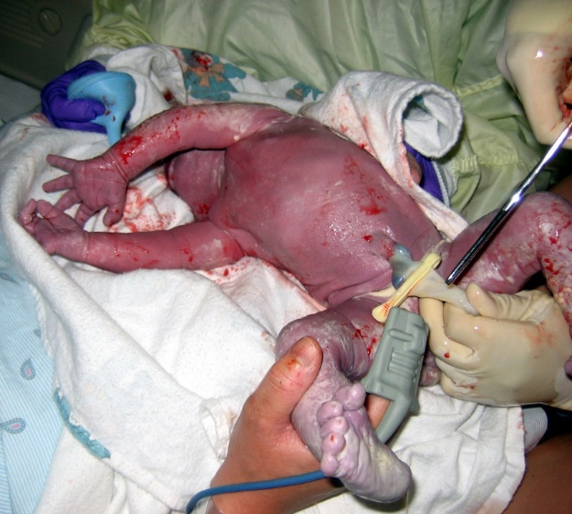
Characteristics of Newborns - Appearance
Misshapen head
Lanugo – downy body hair
Vernix – waxy white substance
Enlarged genitals
Umbilical cord
Image by Upsilon Andromedae is licensed under CC BY 2.0
Image by NNethala is licensed under CC BY-SA 3.0
Image is in the public domain

Slide 8
Further Characteristics of Newborns
Sleep 16.5 out of 24 hours; waking often
Equipped with reflexes
Sensory capacities
Vision is most poorly developed sense
Have keen hearing
Sensitive to touch, temperature, and pain
Have innate taste preferences
Perceive the world in an intermodal way
Image is in the public domain

Slide 9
This PowerPoint was created by Jennifer Paris. Except where otherwise noted, it is licensed under a Creative Commons Attribution 4.0 International License.

